Slide 1
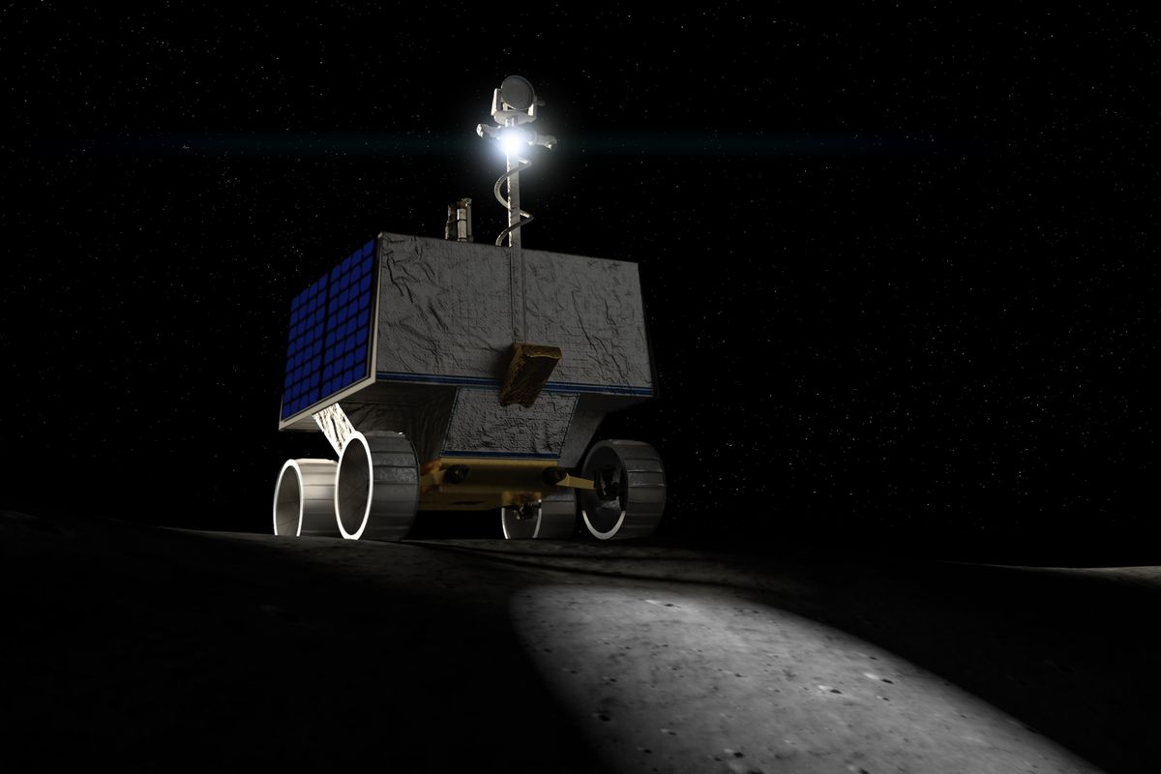
NASA Robotic Mining Competition
Taylor Ertrachter Bailey Hamant James Spies
Faculty Advisor: Dr. Marius Silaghi

Slide 2
Client
Our client is the Aerospace NASA Lunabotics Engineering Competition(LEC) team division.
Our boss is Dr. Kimberly Demoret, the Aerospace team advisor.

Slide 3
Meeting Schedule
We meet once a week on Mondays at 5:00pm. At 5:30pm Dr. Demoret joins our meetings.
We may also have Software subteam meetings to discuss software specific questions. These meeting include the 3 of us, as well as Steven, our subteam lead, and sometimes Nathaniel, the overall NASA LEC team lead.

Slide 4
Goals and Motivations
Partnered with Aerospace majors, our goal is to work on developing the software of the robot to be entered in NASA’s Lunabotics Engineering Competition.

Slide 5
Approach
We intend to first create a virtual simulation and test environment to run the software on, both to avoid damaging the actual hardware and to be prepared in the event that the hardware is not finished by the date of the showcase.

Slide 6
Approach
Our system will implement these key features:
Manually controllable robot actions for all major motors (navigation, claw, conveyor belt) through Xbox wireless controller
Object detection for future autonomous navigation
Fully autonomous sample collection, navigation, and deposition system using manual controls as backup

Slide 7
Novelty Feature
Having an autonomous robot is the key feature of this project. Implementing an AI to a robot designed to navigate an obstacle course and excavate minerals will be very a very interesting and challenging goal.

Slide 8
Technical Challenges
Client has requested that the code be written in Python for readability purposes, meaning that all of our controls for the robot will require libraries that we are unfamiliar with
We are using APIs that we are unfamiliar with for the object detection camera and motor controls
We have limited experience with object detection and automation
Online learning

Slide 9
Milestone One
Create a virtual environment in which we can test robot controls on a simulated level.
We will be able to work on code for specific functions even if the hardware has not been finished for it.
We want this simulation completed ASAP so we can get visuals on how the code is running.

Slide 10
Milestone Two
Implementing Python controller for robot.
Implementing an operable arm controller based on controller input.
Implementing a moving conveyor belt.

Slide 11
Milestone Three
Implementing the camera’s vision into the code.
Implementing the camera code into the robot’s actions.
Implementing different actions based on different objects.

